Slide 1
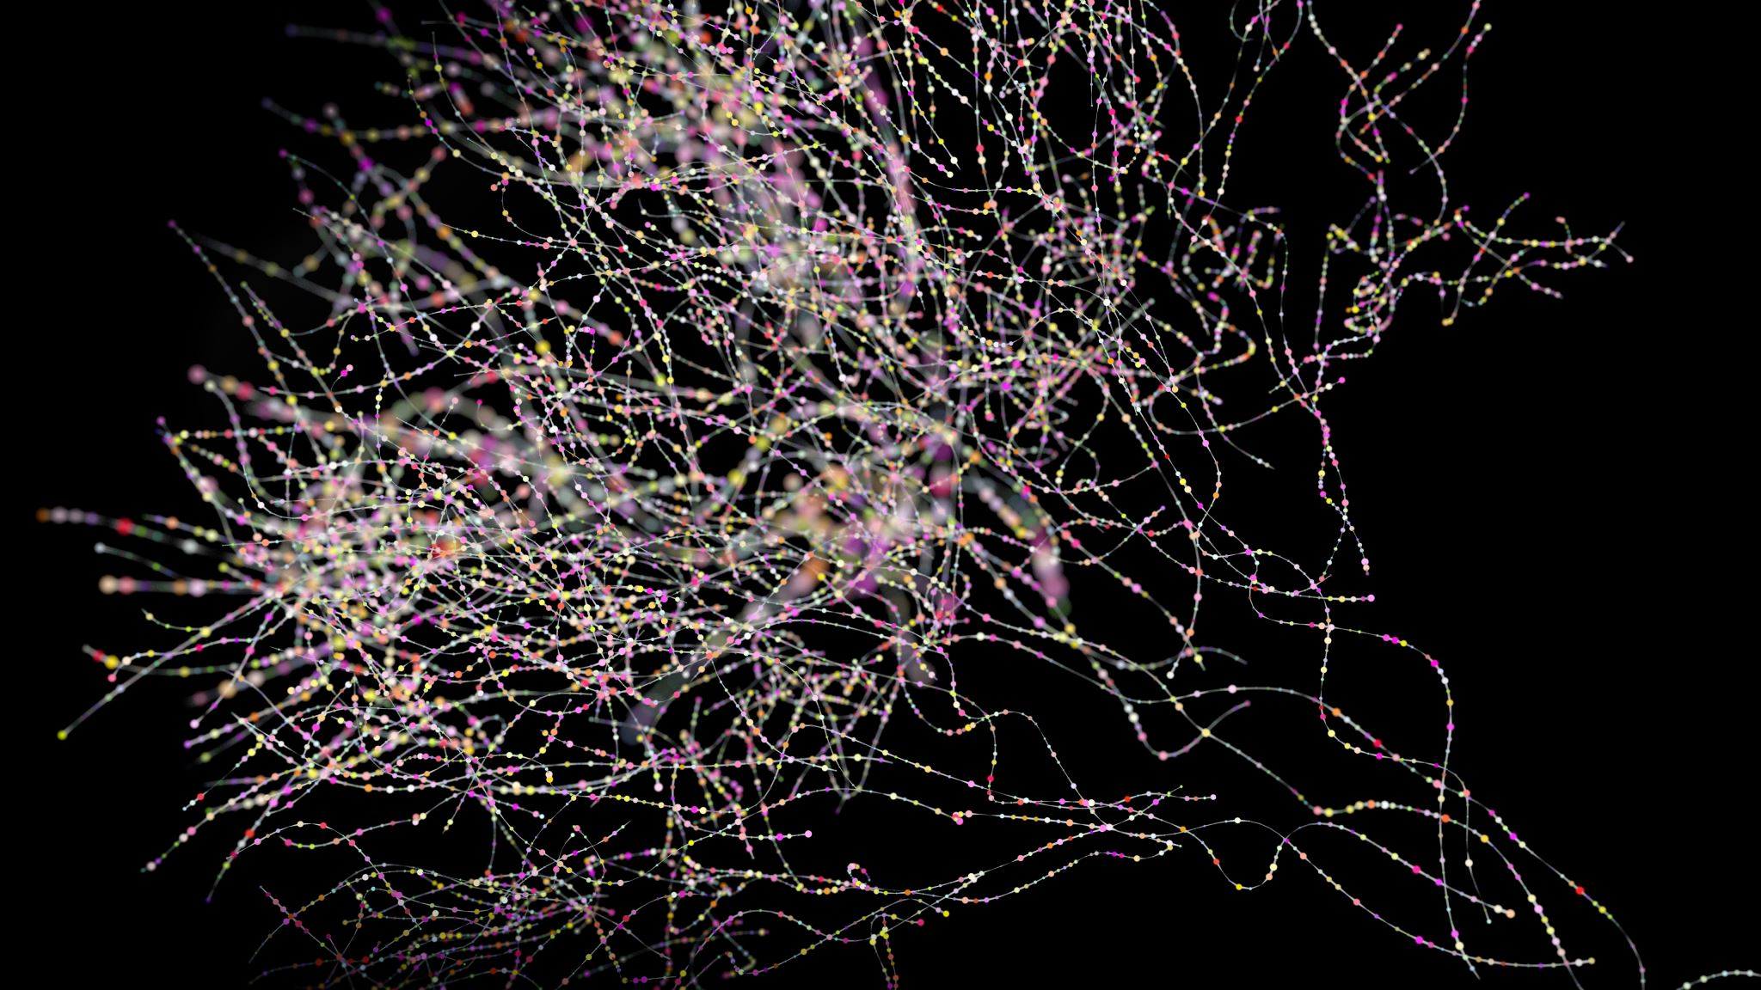
Clustering
Mahipal Singh

Slide 2
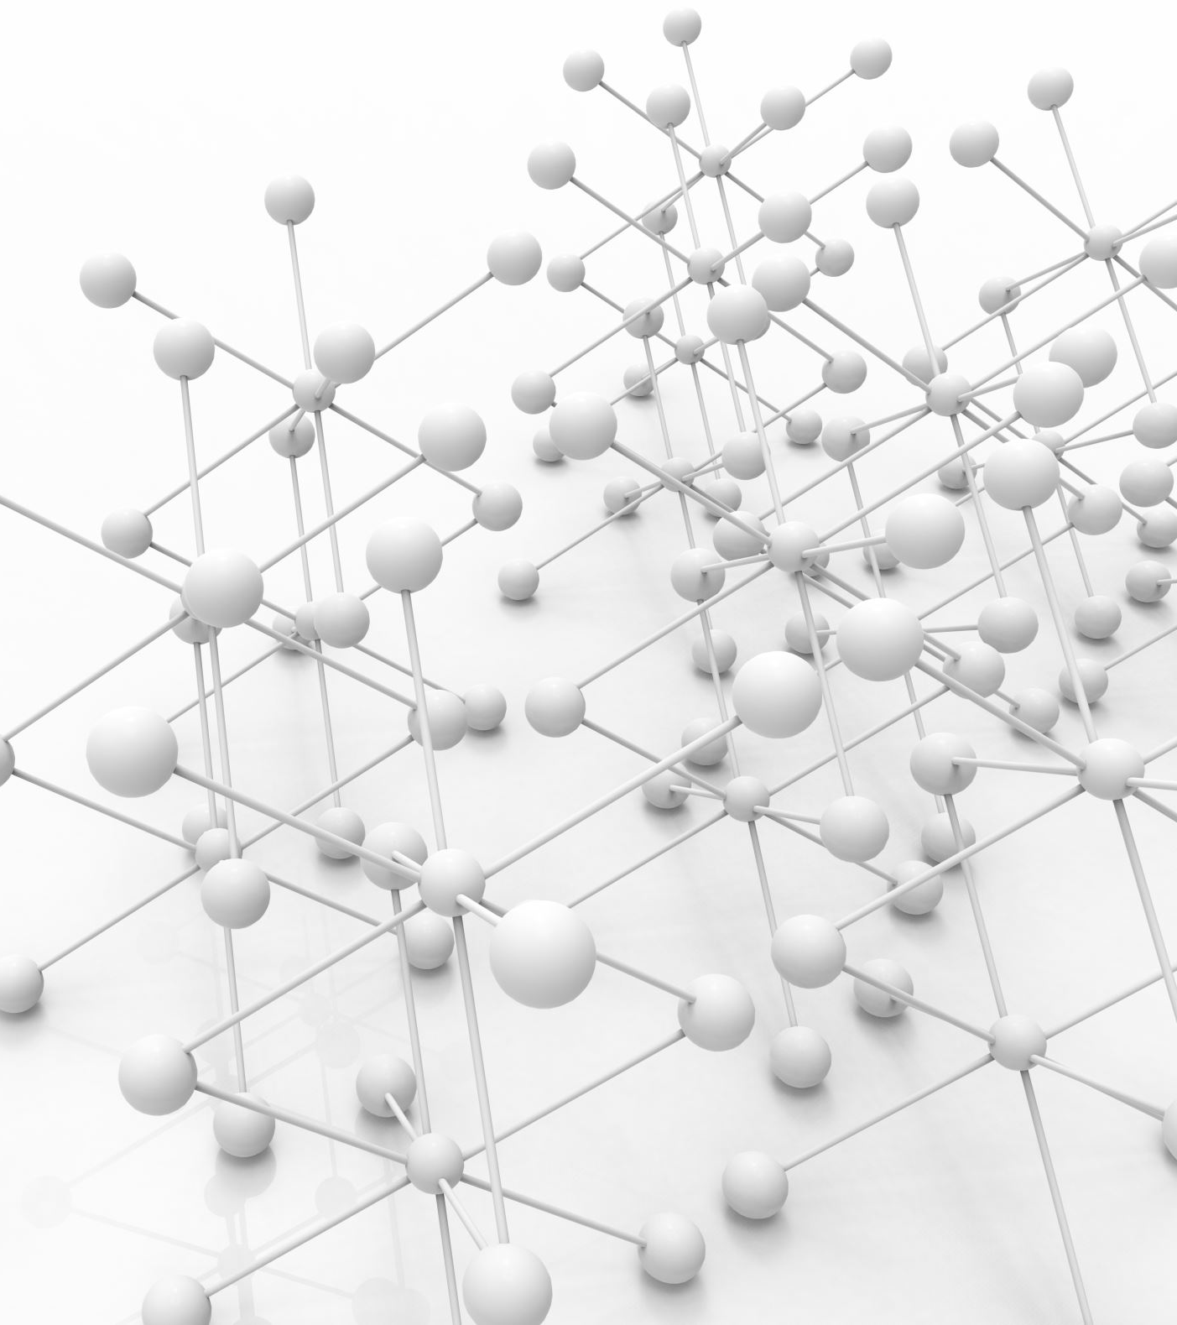
Clustering
Clustering is an unsupervised learning technique used to group similar data points together based on their features.
No labels provided — the model finds structure in the data.
Goal: Group similar data points into clusters such that:
Points within a cluster are similar.
Points across clusters are dissimilar.

Slide 3
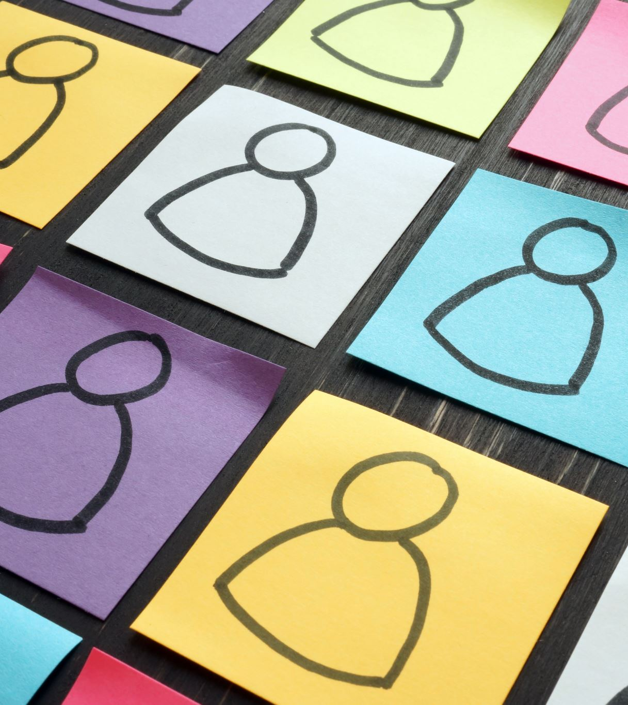
Real-Life Examples
📸 Photo organization (by faces, locations)
🎵 Music/movie recommendations (grouping similar users)
🛍️ Market segmentation (grouping customers by behavior)
📊 Anomaly detection (fraud detection, outliers)

Slide 4
Types of Clustering Algorithms
1. K-Means Clustering (most common)
2. Hierarchical Clustering
3. DBSCAN (Density-Based Spatial Clustering of Applications with Noise)

Slide 5
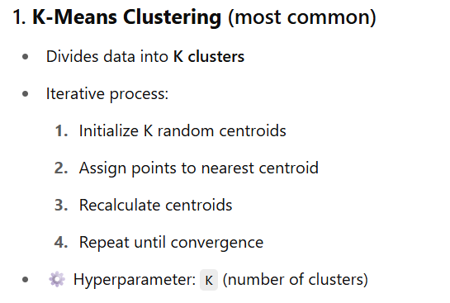

Slide 6
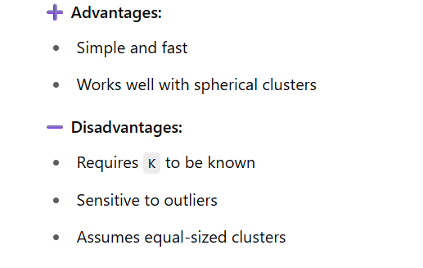
Continue..

Slide 7
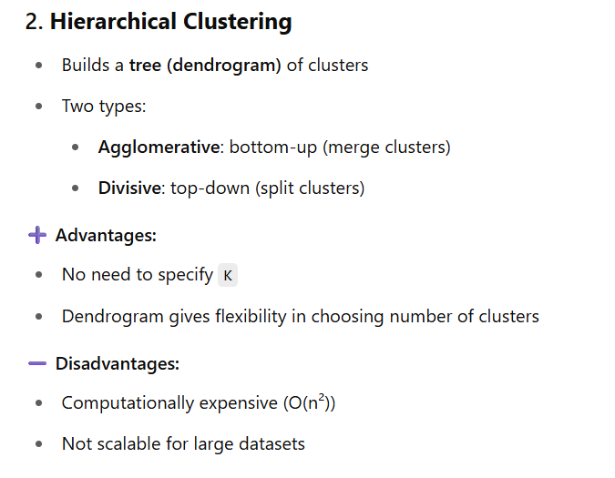

Slide 8
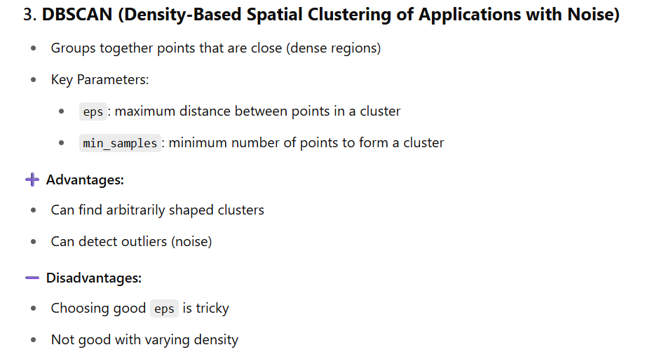

Slide 9
Evaluation Metrics
1. Inertia (Within-Cluster Sum of Squares - WCSS)
2. Silhouette Score
3. Davies-Bouldin Index (DBI)
4. Calinski-Harabasz Index (a.k.a. Variance Ratio Criterion)

Slide 10
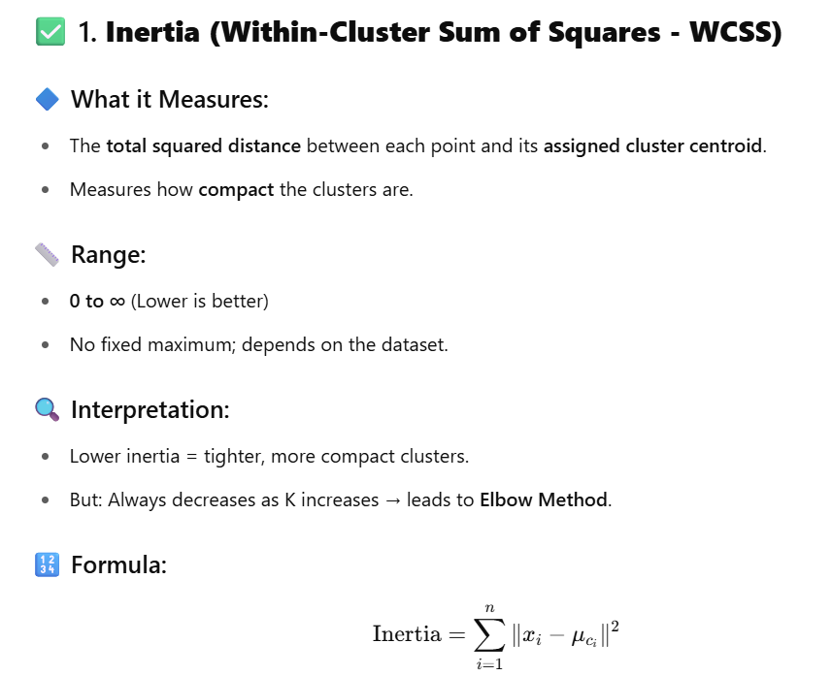

Slide 11
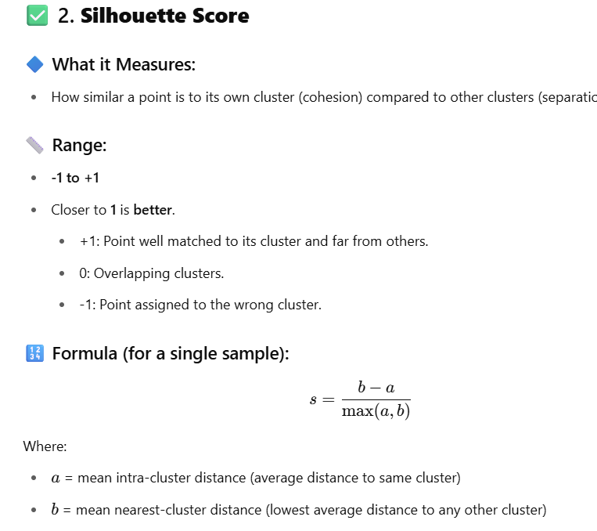

Slide 12
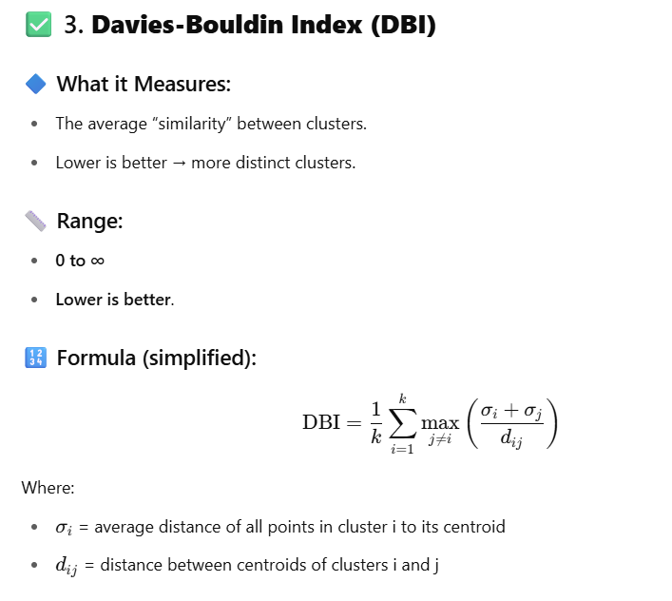

Slide 13
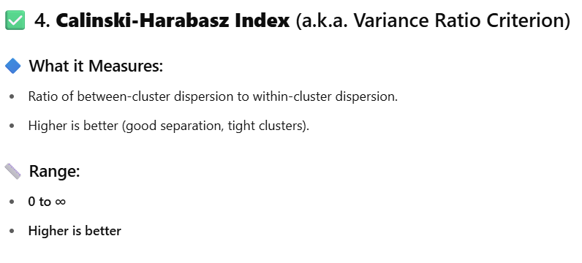

Slide 14
